Slide 1
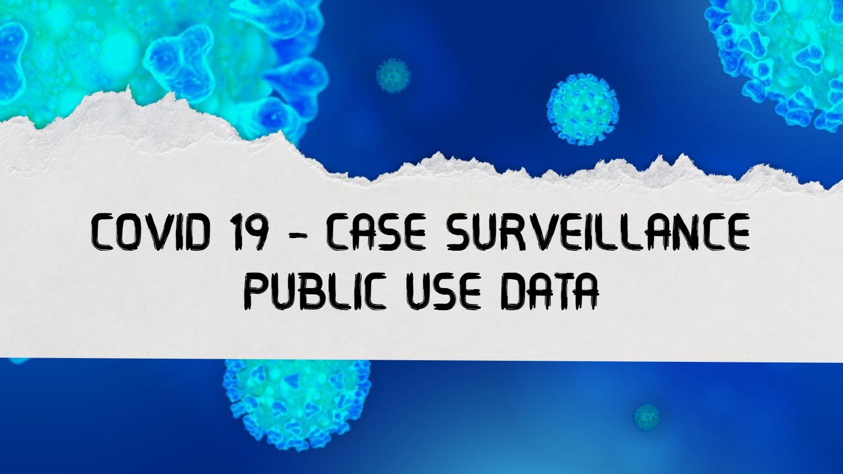

Slide 2

INTRODUCTION

Slide 3
COVID-19 is not only a global pandemic and public health crisis that emerged last 2019, but it has also had a significant impact on the global economy and markets, including establishments and other businesses where we, the people, used to go. This virus outbreak has been therefore a long time, yet we are still in the grip of a pandemic.

Slide 4
According to Teutsch, S. (2000), public health surveillance is the systematic, ongoing assessment of the health of a community, based on the collection, interpretation, and use of health data. Surveillance provides information necessary for public health decision making.

Slide 5
Summarizing the objective, constraints, and completeness of national COVID-19 case surveillance data could assist enhance and analyze these data over time. We compared counts of COVID-19 cases and deaths from case surveillance data with aggregate counts of cases and deaths compiled by the CDC from jurisdictions

Slide 6
SUSTAINABLE DEVELOPMENT GOALS

Slide 7

Goal 3: Ensure healthy lives and promote well-being for all at all ages

Slide 8
STATEMENT OF
THE PROBLEM

Slide 9
This study was carried out to analyze Covid-19 data, which may help us determine how cases and surveillance improve from time to time in the midst of the pandemic.
The following questions will be the sole focus of this research:
1.) What exactly is a covid-19 case, including a "probable case?"
2.) How important is data tracker in determining covid-19 cases on a regular basis?

Slide 10
3.) How can data sources support in the gathering of information on Covid-19 cases?
4.) What are the limitations of using case surveillance data to gather information on Covid-19 cases?

Slide 11
SIGNIFICANCE OF
THE PROBLEM

Slide 12
The main purpose of this system is to help further decrease and eradicate the number of covid positive, so that the economy would continue to reopen, everything will go back to normal and strive for a covid free and safer community. By doing this, it will help protect ourselves, and our family to getting enough help, support and information from the local government during isolation when notified. Some of the benificiaries and recipients are:

Slide 13
To the Government
To the Public Health Office
To the Patients
To the Future Researchers

Slide 14
METHODS

Slide 15
Over the course of the COVID-19 pandemic, CDC has maintained a count of US cases and deaths by both aggregate and individual means (case surveillance). The CDC collects aggregate counts from jurisdiction websites using both manual and automated means, including a survey of jurisdiction on a daily basis. This is done by calculating the number of COVID-19 cases and deaths occurring in each jurisdiction per day and publishing the information online.

Slide 16
EXPECTED OUTPUTS

Slide 17
The expected output of our topic entitled COVID19-Case Surveillance Public Use Data.
It aims to get the overall data of COVID-19 cases with different race and ethnicity. It also include the gender, age, status of the patient and its CDC report.

Slide 18
COVID-19 CASE
DATA SET

Slide 19
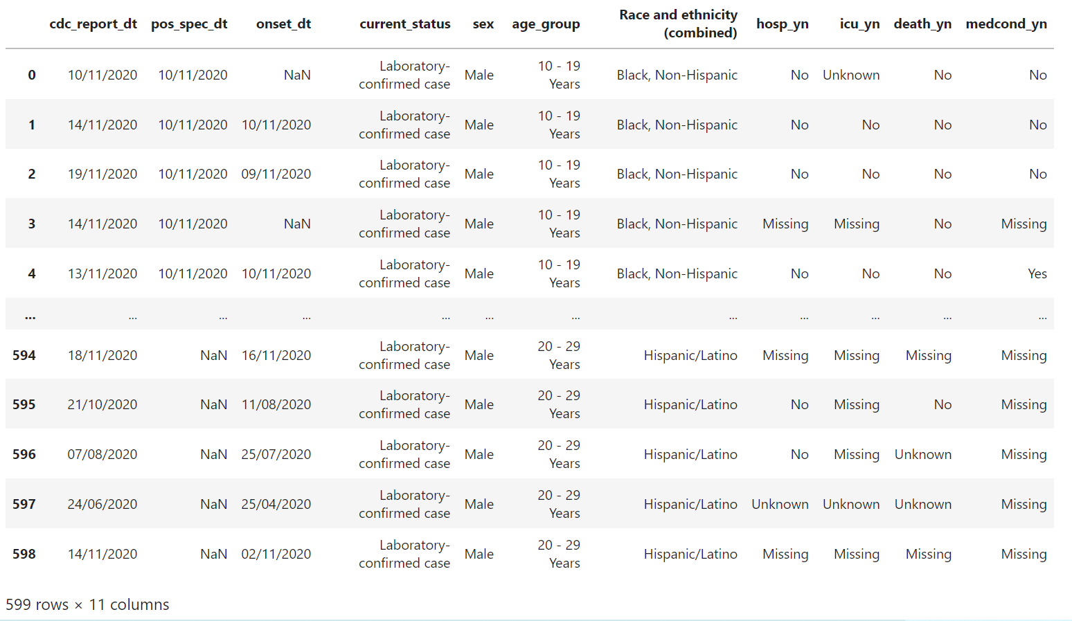

Slide 20
DATA CLEANING

Slide 21
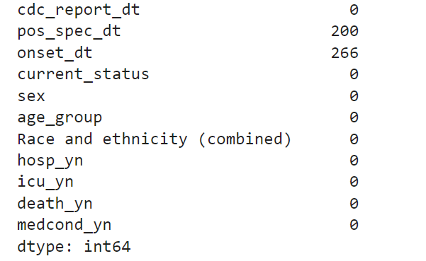
Checking Nulls

Slide 22
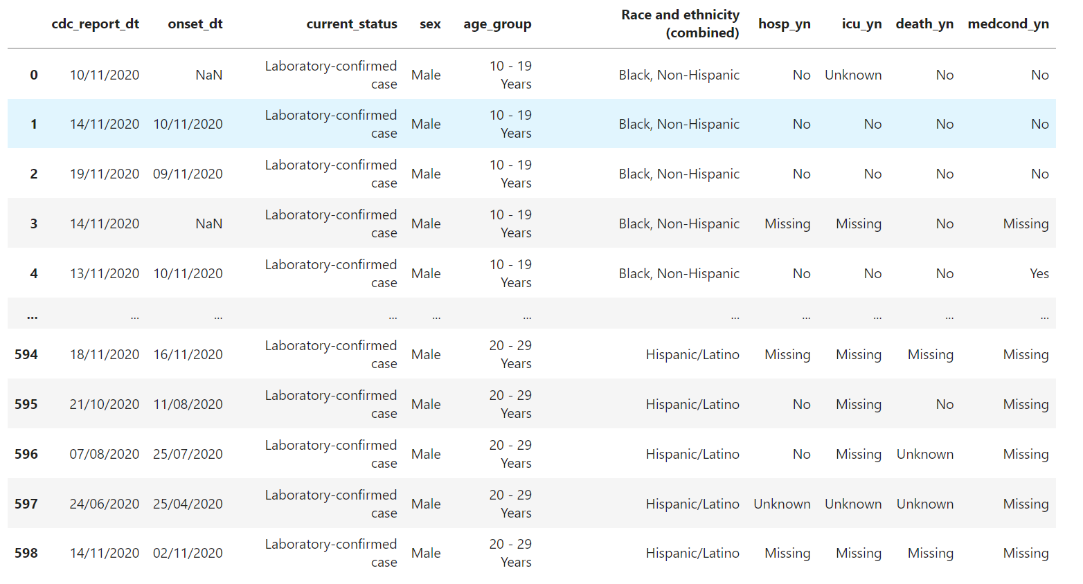
Removing Columns

Slide 23
DATA VISUALIZATION

Slide 24
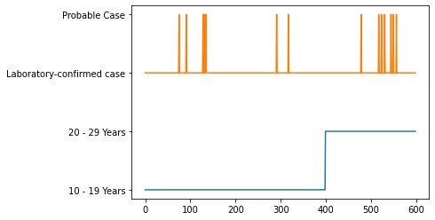
SCATTER GRAPH

Slide 25
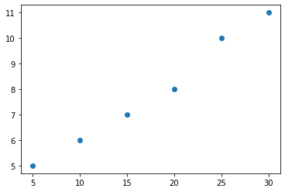
SCATTER PLOT

Slide 26
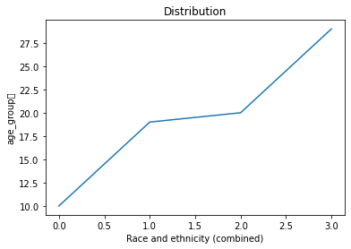
LINE GRAPH

Slide 27
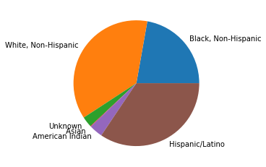
PIE CHART

Slide 28
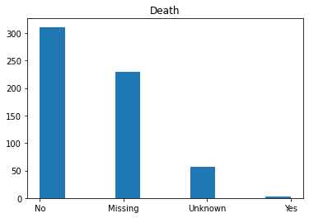
HISTOGRAM

Slide 29
THANKYOU!

